Slide 1
UNIT TWO- Part Two

Slide 2
Planning
Planning involves selecting missions and objectives and the actions to achieve them, it requires decision-making that is choosing future courses of action from among alternatives. Plans thus provide a rational approach to achieving pre-selected objectives.

Slide 3
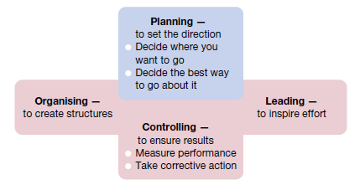

Slide 4
Types of Plans
mission or purpose
the mission or purpose identifies the basic function or the task of an enterprise or an agency or any part of it.

Slide 5
Objectives
This is the first step in planning the action plan of the organization. Objectives are the basics of every company and the desired objective/result that the company plans on achieving, so they are the endpoint of every planning activity.

Slide 6
Strategy
This obviously is the next type of plan, the next step that follows objectives. A strategy is a complete and all-inclusive plan for achieving said objectives. A strategy is a plan that has three specific dimensions
Establishing long-term objectives
Selecting a specific course of action
allocating the necessary resources needed for the plan
Forming strategy is generally reserved for the top level of management. It actually defines all future decisions and the company’s long-term scope and general direction.

Slide 7
Policy
Policies are generic statements, which are basically a guide to channelize energies towards a particular strategy. It is an organization’s general way of understanding, interpreting and implementing strategies. Like for example, most companies have a return policy or recruitment policy or pricing policy etc.
Policies are made across all levels of management, from major policies at the top-most level to minor policies. The managers need to form policies to help the employees navigate a situation with predetermined decisions. They also help employees to make decisions in unexpected situations.

Slide 8
Procedure
Procedures are the next types of plan. They are a stepwise guide for the routine to carry out the activities. These stepwise sequences are to be followed by all the employees so the activities can be fulfilled in an organized manner.
The procedures are described in a chronological order. So when the employees follow the instructions in the order and completely, the success of the activity is pretty much guaranteed.

Slide 9
Rules
Rules are very specific statements that define an action or non-action. Also, rules allow for no flexibility at all, they are final. All employees of the organization must compulsorily follow and implement the rules. Not following rules can have severe consequences

Slide 10
Program
Programmes are in-depth statements that outline a company’s policies, rules, objectives, procedures etc. These programmes are important in the implementation of all types of plan. They create a link between the company’s objectives, procedures and rules.

Slide 11
Methods
Methods prescribe the ways in which in which specific tasks of a procedure must be performed. Also, methods are very specific and detailed instructions on how the employees must perform every task of the planned procedure. So managers form methods to formalize routine jobs.

Slide 12
Budget
A budget is a statement of expected results the managers expect from the company. Budgets are also a quantitative statement, so they are expressed in numerical terms. A budget quantifies the forecast or future of the organization.

Slide 13
